Slide 1

THE RECYCLING AND UPCYCLING PLATFORM
Presented by:
Manikhandan Senthilvelu: (002816327)
Neelabh Bhardwaj (002619066)
Shreyas Purkar (002325982)

Slide 2

PROBLEM STATEMENT
Our world faces an urgent waste management crisis marked by overflowing landfills that grow more critical each day. Environmental degradation continues through unchecked pollution and rapid resource depletion. Despite increasing awareness about recycling, we lack effective platforms for the collection, classification, and distribution of recyclable materials. A significant disconnect exists between willing donors and recycling centers, creating a barrier to effective participation. The current system provides no transparency in tracking donated materials through their lifecycle, leaving donors in the dark about their contributions' impact. This makes it impossible to measure and improve our environmental impact through recycling efforts. These challenges create a cycle where participation is discouraged, resources are wasted, and our environment continues to suffer.

Slide 3

OBJECTIVES
Create an integrated digital platform connecting donors, recycling centers, and upcycling organizations.
Establish a transparent tracking system for donated materials throughout their lifecycle Implement an efficient classification and distribution system for recyclable materials
Develop real-time environmental impact reporting to measure and showcase sustainability outcomes.
Build a reliable logistics network for timely collection and delivery of materials.

Slide 4

STAKEHOLDERS , CONTRIBUTIONS, AND USED CASES
System Admin
1.Maintains overview of entire system 2. Accesses comprehensive process data 3. Reviews environmental impact reports 4. Monitors overall system performance

Slide 5
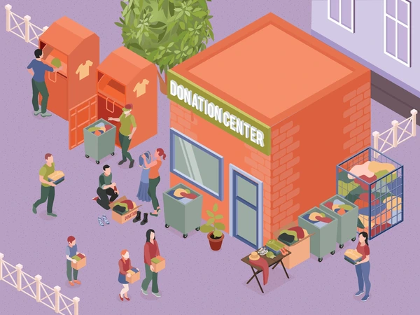
STAKEHOLDERS AND CONTRIBUTIONS AND USED CASES
Donation Centers
1. Serve as primary collection points for recyclable materials. 2. Receive and temporarily store donated items. 3. Interface between donors and recycling centers. 4. The Initial point of material entry into the system Donors 1. Contribute recyclable materials to the system 2. Perform initial categorization of donated items 3. Submit items through donation centers

Slide 6

STAKEHOLDERS AND CONTRIBUTIONS AND USED CASES
Recycling Admin
1. Oversees recycling center operations. 2. Initiates pickup requests from donation centers. 3. Coordinates with delivery agents Manages incoming material flow.
Recycling Manager
1. Verifies and corrects item categorization 2.Updates recycling status of materials Manages recycling process workflow

Slide 7

STAKEHOLDERS AND CONTRIBUTIONS AND USED CASES
Delivery Agents
1. Transport materials between all facilities 2. Update delivery status in real-time Handle logistics between donation centers, recycling centers, and upcycling facilities 3. Maintain chain of custody documentation

Slide 8
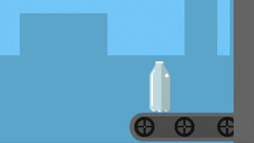
STAKEHOLDERS AND CONTRIBUTIONS AND USED CASES
Upcycling Admin
1 .Initiates pickup requests for recycled materials 2. Coordinates with delivery agents for material transport 3. Manages incoming recycled materials Oversees upcycling operations
Upcycling Manager
1. Manages upcycling process Updates status of upcycled items 2. Oversees quality control of upcycled products 3. Finalizes upcycling workflow

Slide 9

DESIGN AND IMPLEMENTATION TECHNIQUES
Modular Architecture: The System is divided into modules like Donor Management, Recycling Centers, Upcycling Organizations, and Logistics Services for scalability and maintainability.
Role-Based Access Control: Specific roles (Donor, Recycling Staff, Admin) have tailored permissions and functionalities.
Object-Oriented Design: Classes for roles (e.g., Donor, DeliveryAgent) and enterprises (RecyclingCenters, UpcyclingOrganizations) using inheritance for efficiency.
Lifecycle Management: Tracks the status of recyclable items (e.g., Submitted, Classified, Upcycled) across the platform.
User-Friendly UI: Designed with Java Swing, using tables, dropdowns, and interactive panels for a consistent experience.

Slide 10
DESIGN AND IMPLEMENTATION TECHNIQUES
Backend with Java: Uses Object-Oriented Programming and database utility for streamlined database interactions. Database Management: DB4O is used for object storage; item statuses (Classified, Processed) are tracked. Status-Based Workflows: Ensures seamless transitions in item lifecycles using status updates. Reporting and Analytics: Generate Environmental Impact Analysis Reports for donor transparency. Error Handling: Robust error-handling and logging mechanisms ensure system reliability

Slide 11
ThankYou!

